Slide 1
Stock Traders Application
Alyssa Younger
John Ryan
Kamalnivas Balasubramanian
Patricia Rajamanickam

Slide 2
Topics
Background
Analysis
Predictions
Challenges
Expansion Ideas
Questions

Slide 3
Background
Apply the learnings from the course to build a dashboard for investors & traders to make informed financial decisions.

Slide 4
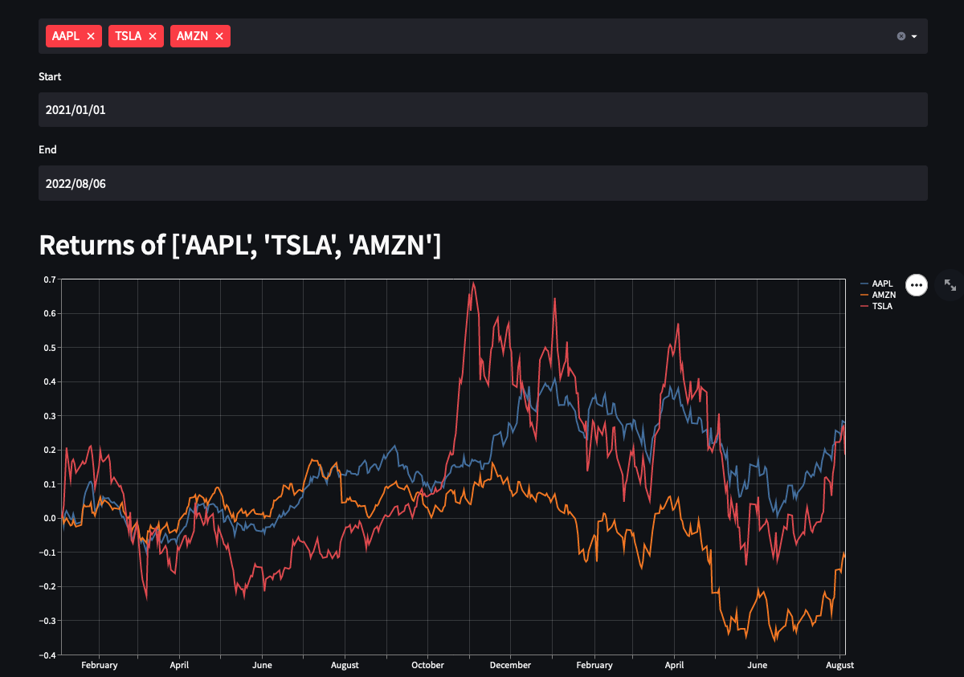
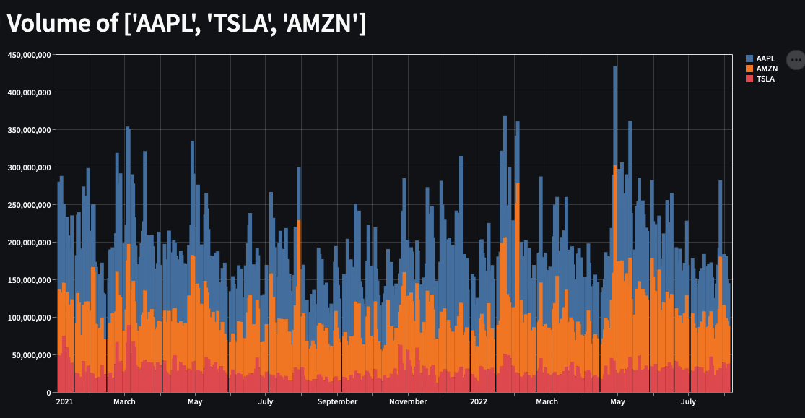
Insights
Returns
Volume

Slide 5
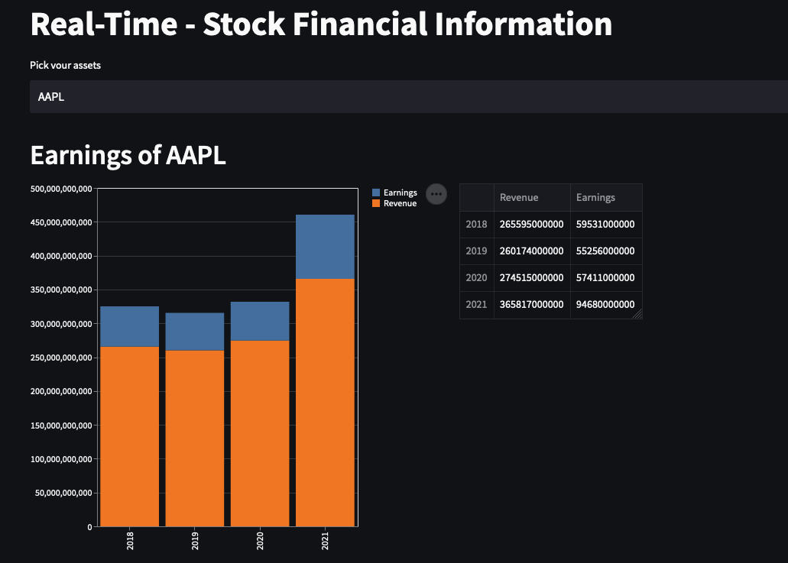
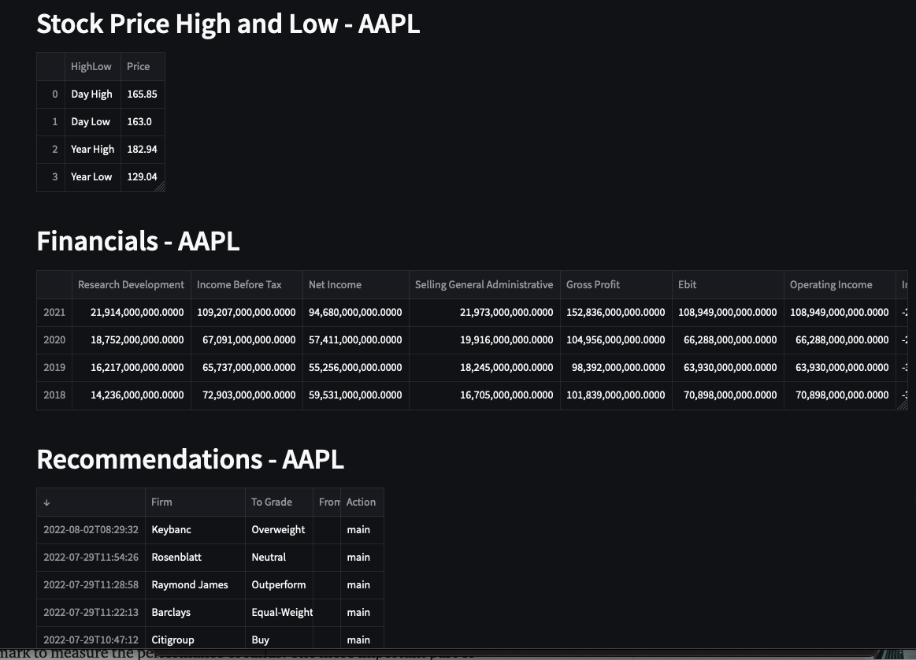
Financials

Slide 6
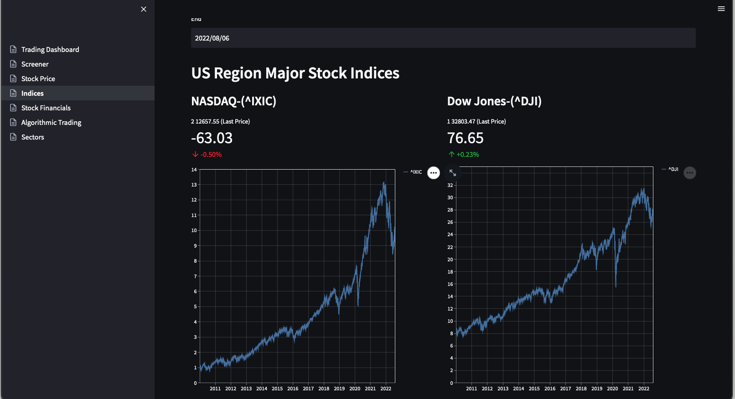
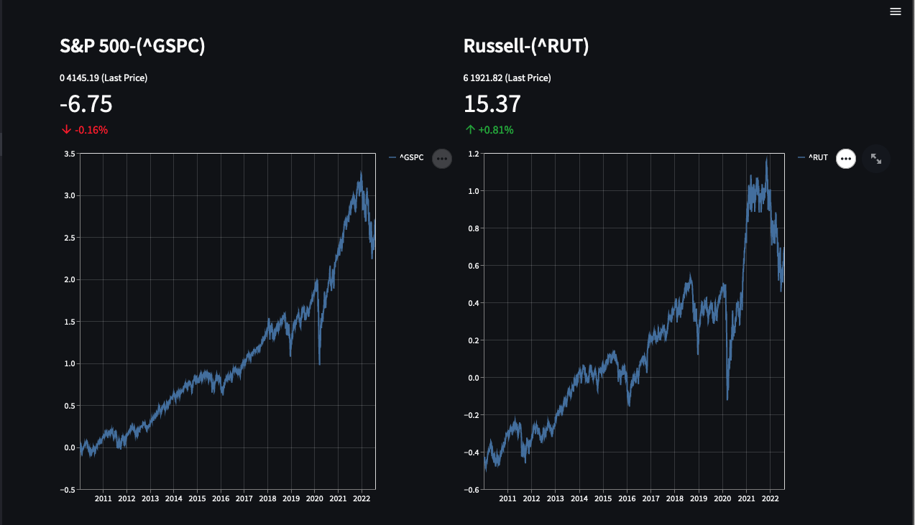
US - Stock Indices

Slide 7
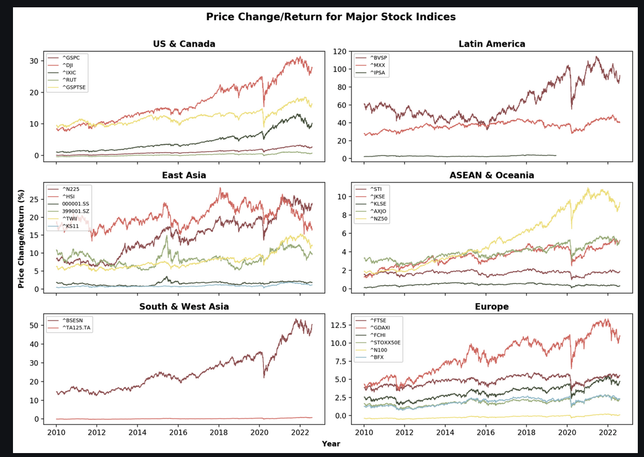
World - Stock Indices

Slide 8
Screener
Goal: Screen stocks to identify new stocks from a pool based on a set of criteria.
Limit the pool of stocks to NASDAQ100.
The criteria used to screen the pool are the market cap & sector info.
This idea can be very easily extended to a much larger pool of stocks & more customized criterias.

Slide 9
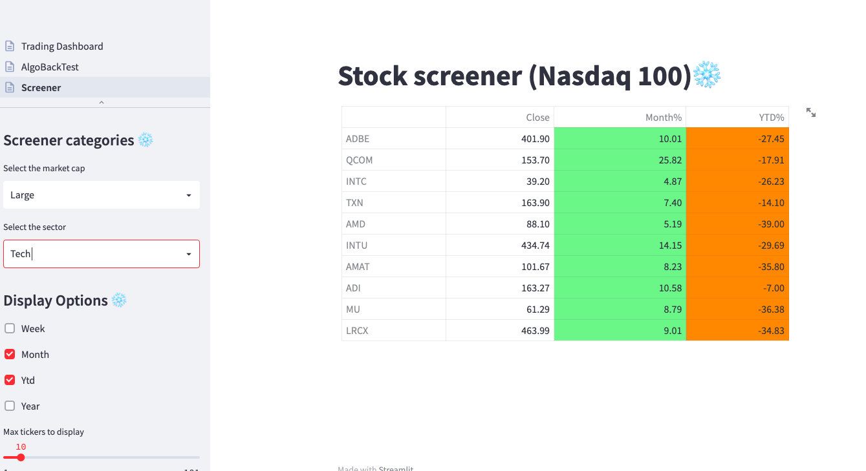
Screener

Slide 10
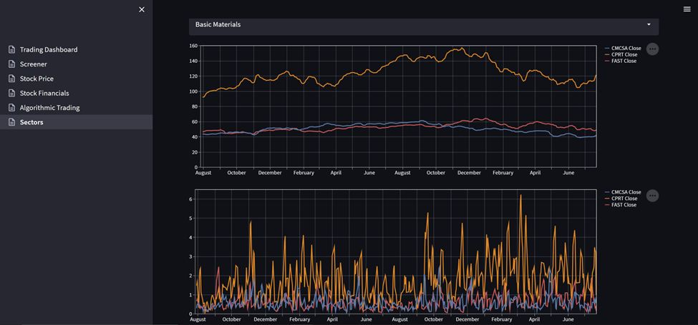
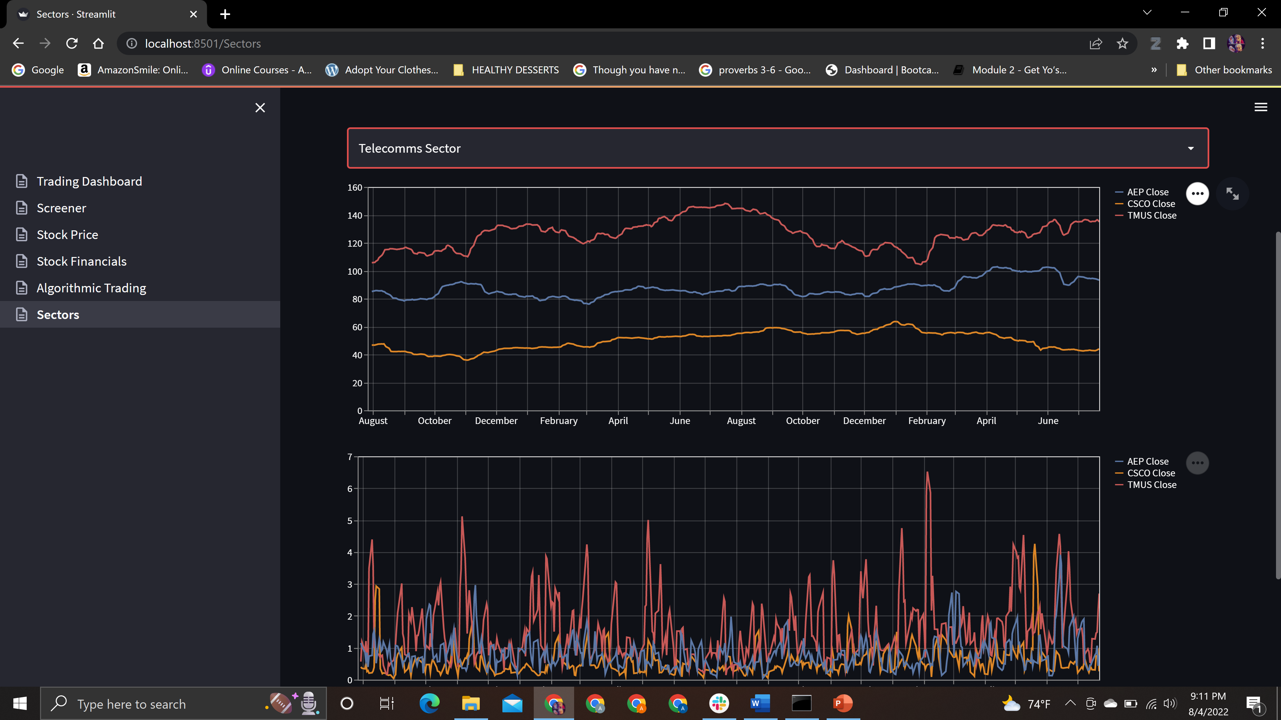
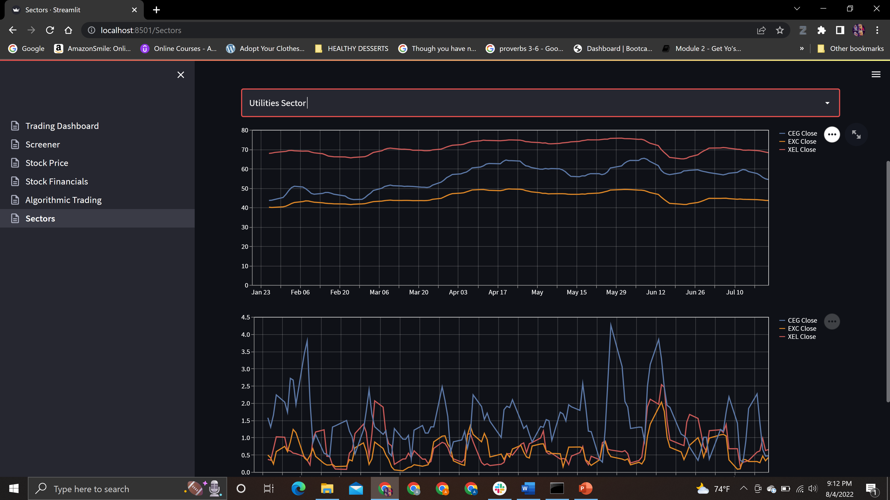
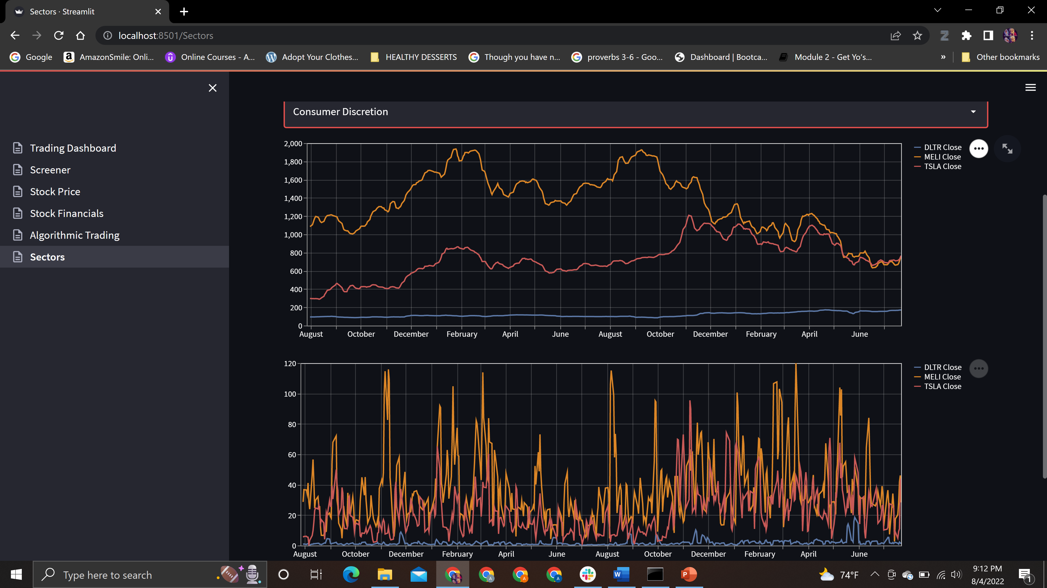
Rolling Averages and Volatility Set as of July 25th

Slide 11
Predictions & Algorithmic Trading
DMAC (Dual Moving Average Crossover) Algorithmic Trading Model
Applied this strategy across companies in the NASDAQ-100
Roughly 2 years of trading data
Entry / exits signals with projected profits/losses as well ROI (return on investment)
Profit and Loss / ROI computations assume standard trade qty of 100 shares per buy trade
Enhancements
Customizable short and long windows
Differing trade quantities
Layering more detail into the algo strategy

Slide 12
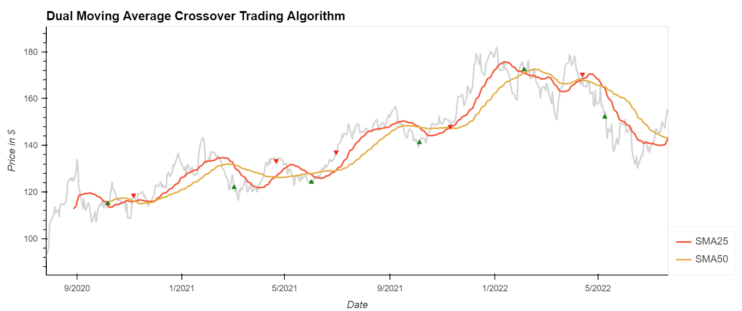
Predictions & Algorithmic Trading cont’d

Slide 13
Challenges
Learning yfinance library and it is incredible for prototyping. Perhaps got faculty data and had to do lot of pre-processing gimmicks to analyze the ticker information.
Visualization in Streamlit.
Resource limitation in Streamlit.
Identify and apply appropriate Algo trading strategy.

Slide 14
Expansion ideas
The screener can be extended to wider pool of stocks, ETFs & other securities.
If integrated with a user based database, we could even push notifications based on the screening criteria.
The algo trading tool can provide a lot more commonly used algorithms while allowing the user to backtest the algorithm before deploying it in real-time.
Application can be widened for Cryptocurrency.
Broaden the Algo trading to execute trades at precise moments for different categories of investors
long-term
Short-term
Systematic Traders.

Slide 15
Questions?

